Slide 1

RPPOOP Mini Project
Easy-Note: Note Taking Application
Made By:
111903020 : Apurva Deshpande
111903030 : Chitrang Bhoir
111903026 : Sham Targe
COMPUTER DEPARTMENT-COEP

Slide 2
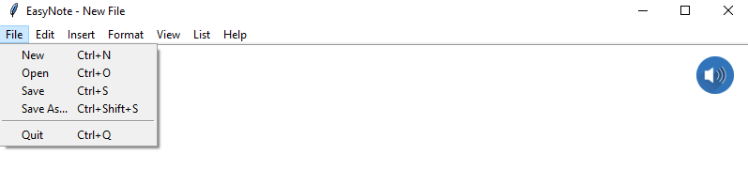
Contents
Introduction
Functionalities Implemented
Concepts Used
Output
References

Slide 3
Introduction
Problem Statement : Note Taking Application in Python
Features:
User can Create, Save, Edit Notes in Files
Files are stored to Local Storage in User’s Computer
User can make To do List along with the notes to manage their tasks
Text to Speech Option which recites text typed by User in the File
Variety of Fonts, Backgrounds to choose from while writing

Slide 4
Tools and Modules Used
Languages Used: Python
GUI Implemented using Python tkinter Package
Tkinter Modules used:
messagebox, filedialog : File option
pyttsx3 : Text to Speech option
tkfontchooser: Font option
PIL : Display icons and images
datetime : Display current date and time

Slide 5
Functionalities Implemented
New
Save
Save As
Open
Quit
FILE
Undo
Redo
Cut
Copy
Paste
Select All
EDIT
Statusbar-
Line, Column, Character Count
Date and Time
VIEW
Bold
Italics
Font
Word Wrap
Highlight
Text Colour
Background colour
Night Mode
FORMAT

Slide 6
Functionalities Implemented
Make a List
LIST
Text To Speech
TEXT TO SPEECH
Help
About the App
HELP

Slide 7
Concepts Used
ENCAPSULATION
All Data Members and Member Functions for each component are wrapped inside classes
ABSTRACTION
Implementation Details are hidden from User and only Function declarations are used in Widgets
INHERITANCE
All Components on main window inherit features from tkinter Widgets and Classes
EVENT HANDLING
All features are implemented in Interactive GUI and user friendly shortcuts
FILE HANDLING
Files created by user can be edited, saved and opened using File Operations

Slide 8
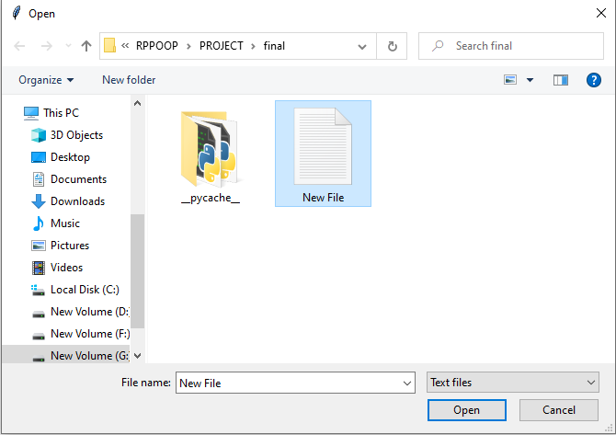
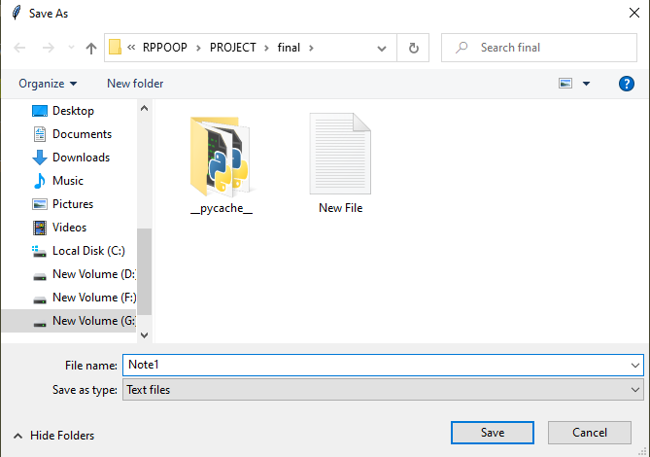
Output
1)OPEN : 2)SAVE AS :

Slide 9
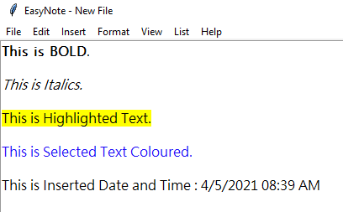
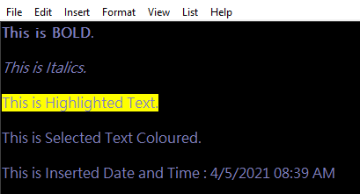
3)FORMAT FUNCTIONALITIES

Slide 10
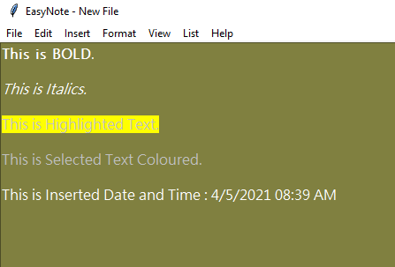
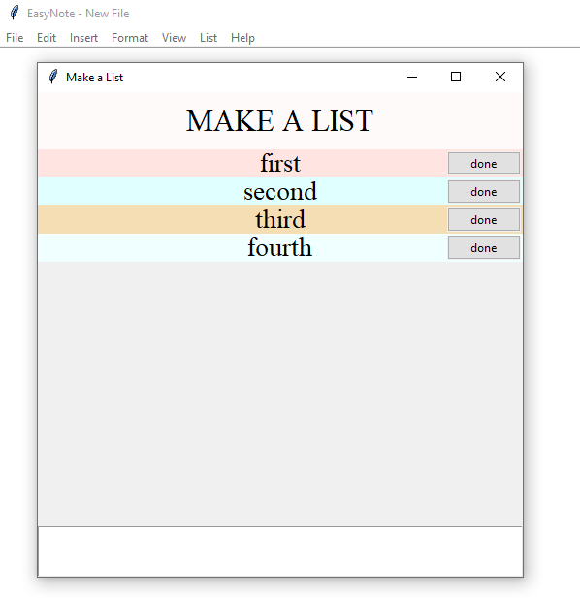
4)CHANGE BACKGROUND COLOUR 5)MAKE LIST

Slide 11
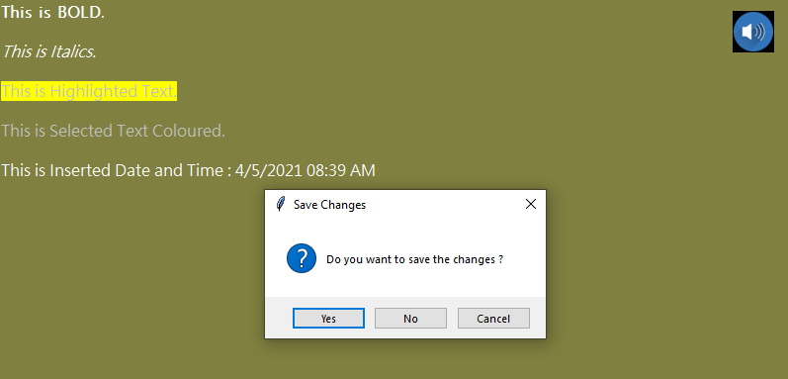
6) SAVE BEFORE QUITTING 7) TEXT TO SPEECH

Slide 12
References
https://docs.python.org/3/library/tkinter.html
https://www.geeksforgeeks.org/python-gui-tkinter/
https://pythonprogramming.net/object-oriented-programming-crash-course-tkinter/
https://www.pythontutorial.net/tkinter/tkinter-object-oriented-window/

